Slide 1
NODE.JS
(The Backend Of MERN Stack)
Lecture 20

Slide 2
Today’s Agenda
Connecting HTML Forms With Express
Handling GET Request Through Form
Handling POST Request Through Form
Extracting Request Data
Exercises

Slide 3
Exercise 47
Develop a full stack web application to perform addition of 2 integers given by the user.
Your application should:
Provide a form to the user to input 2 nos
Upon submission , these nos must be passed to the server
At the server end , the addition of nos must be done
Finally the result should be displayed

Slide 4
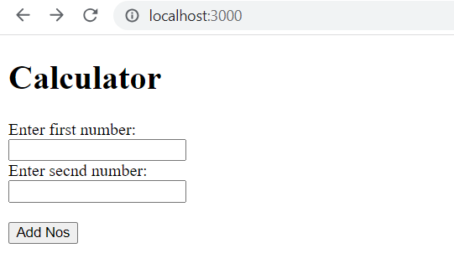
output

Slide 5
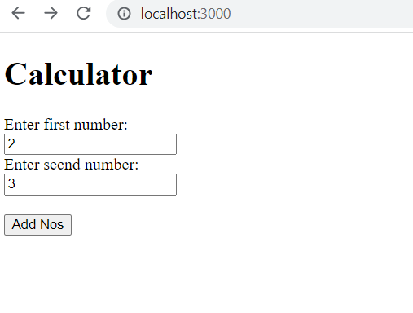
output

Slide 6
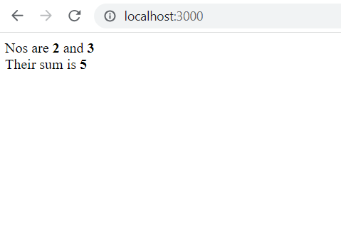
output

Slide 7
Steps needed
Create an html page called index.html containing a form tag for accepting 2 numbers.
Set the action attribute of form to “/” and the method attribute to “post”
Create a file called calculator.js for handling 2 routes:
GET / : This will serve the index.html file
POST / : This will extract the numbers passed from the HTML page , add them and send back the sum as the result

Slide 8
How to get form data ?
To extract form data we need to use a middleware function as shown below:
app.use(express.urlencoded({ extended: false }));
Whenever the user sends POST requests by submitting a form, browser will use application/x-www-form-urlencoded as the content-type to send the data.

Slide 9
How to get form data ?
To parse that data from the request body, we need to use the urlencoded() method.
With the extended option, we can choose between the query-string library or the qs library to parse the URL-encoded data.
We can set this option as true or false.

Slide 10
How to get form data ?
If it is set to false then the urlencoded() method will use the query-string library.
When the extended is true, this method will use the qs library.

Slide 11
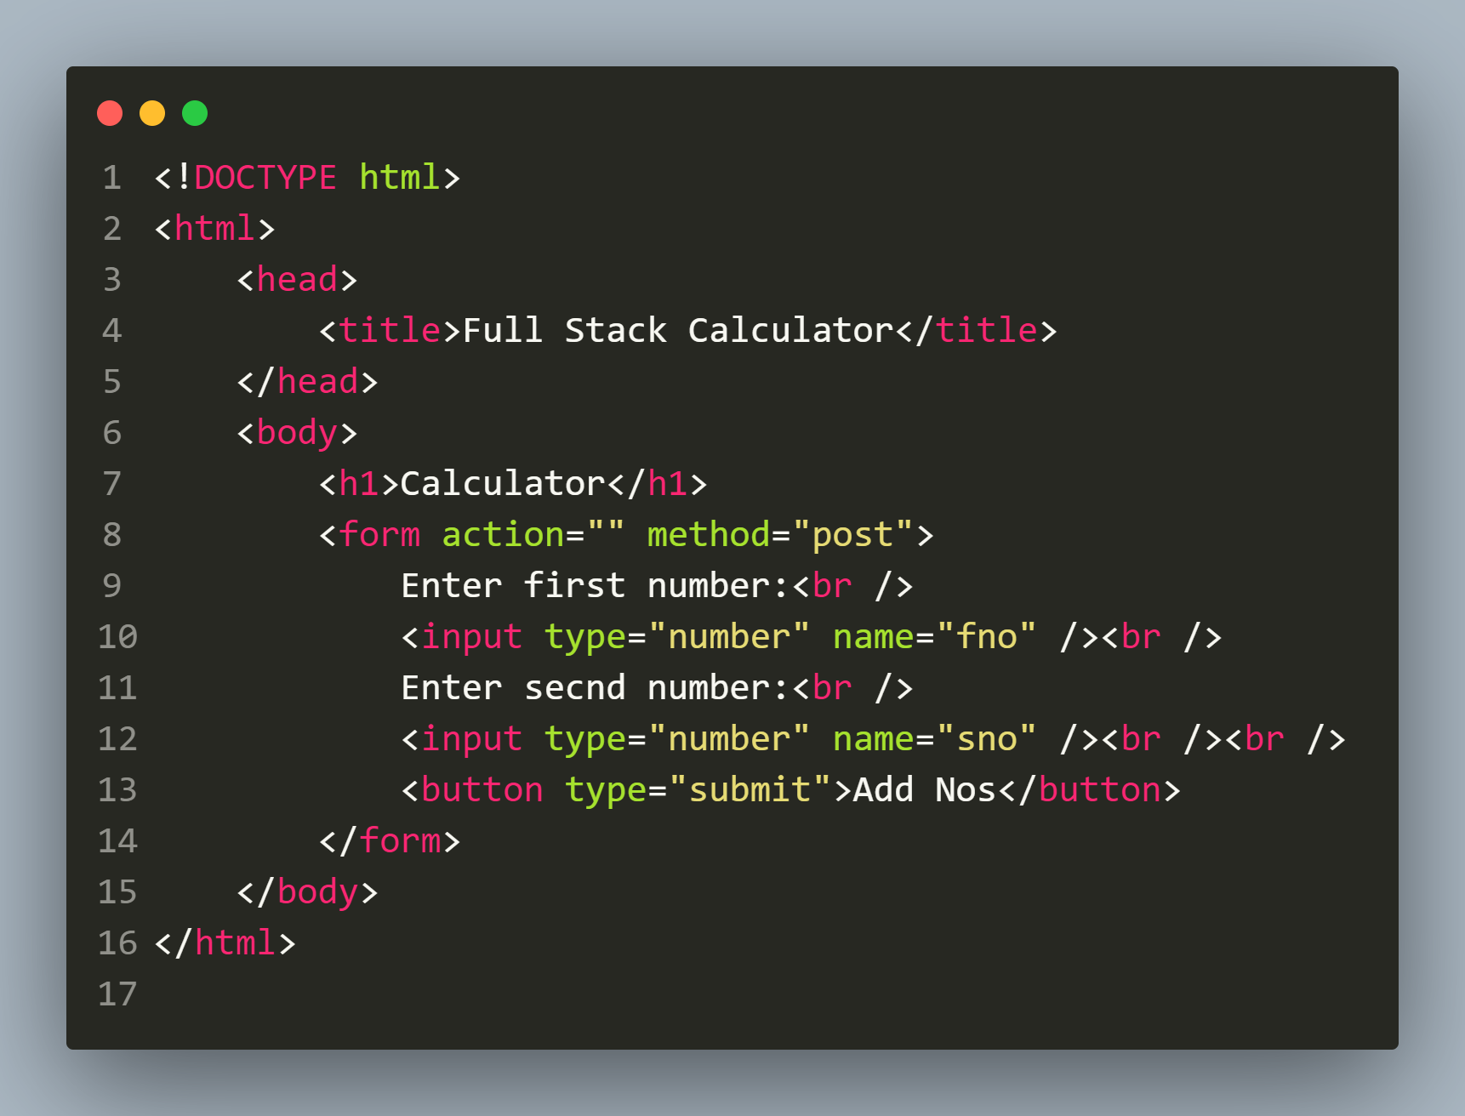
Solution
index.html

Slide 12
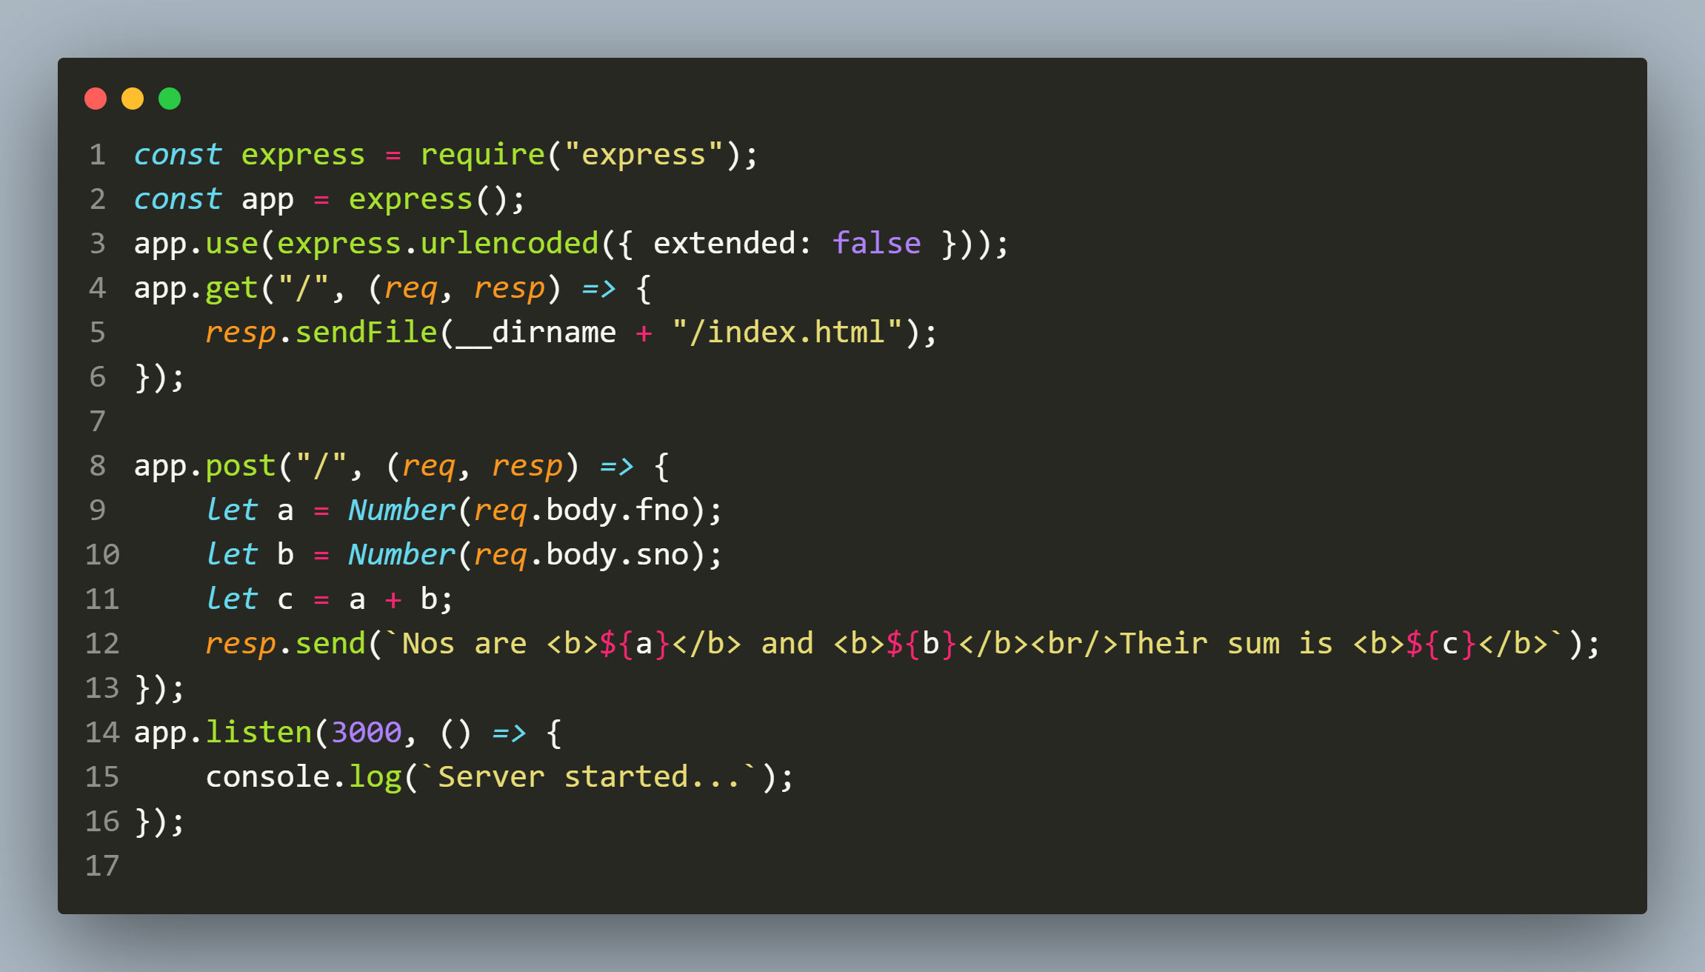
Solution
calculator.js

Slide 13
Exercise 48
Modify the previous Calculator application to perform conversion of Indian Rupee to a currency as chosen by the user.
Your application should :
Provide a form to the user to input an amount and choose the target currency amongst Dollar, Euro and Pound.
Upon submission , the amount , and target currency must be passed to the server
At the server end , the conversion of amount must be done
Finally the result should be displayed
Special Note :To accomplish the above task your application will need to handle 2 more routes .

Slide 14
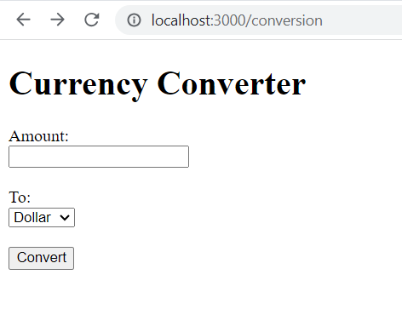
output

Slide 15
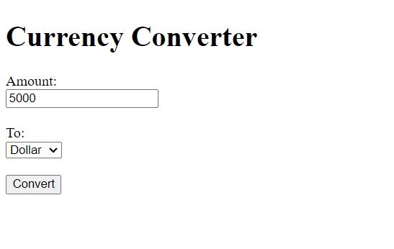
output

Slide 16
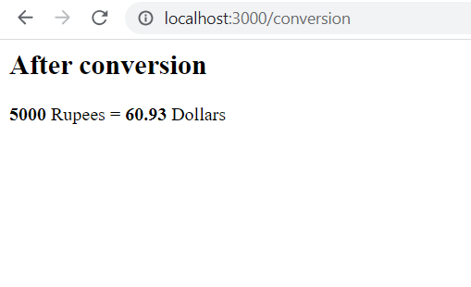
output

Slide 17
Conversion table
Currency | Rupee
1 Dollar | 82.06
1 Pound | 104.89
1 Euro | 89.55

Slide 18
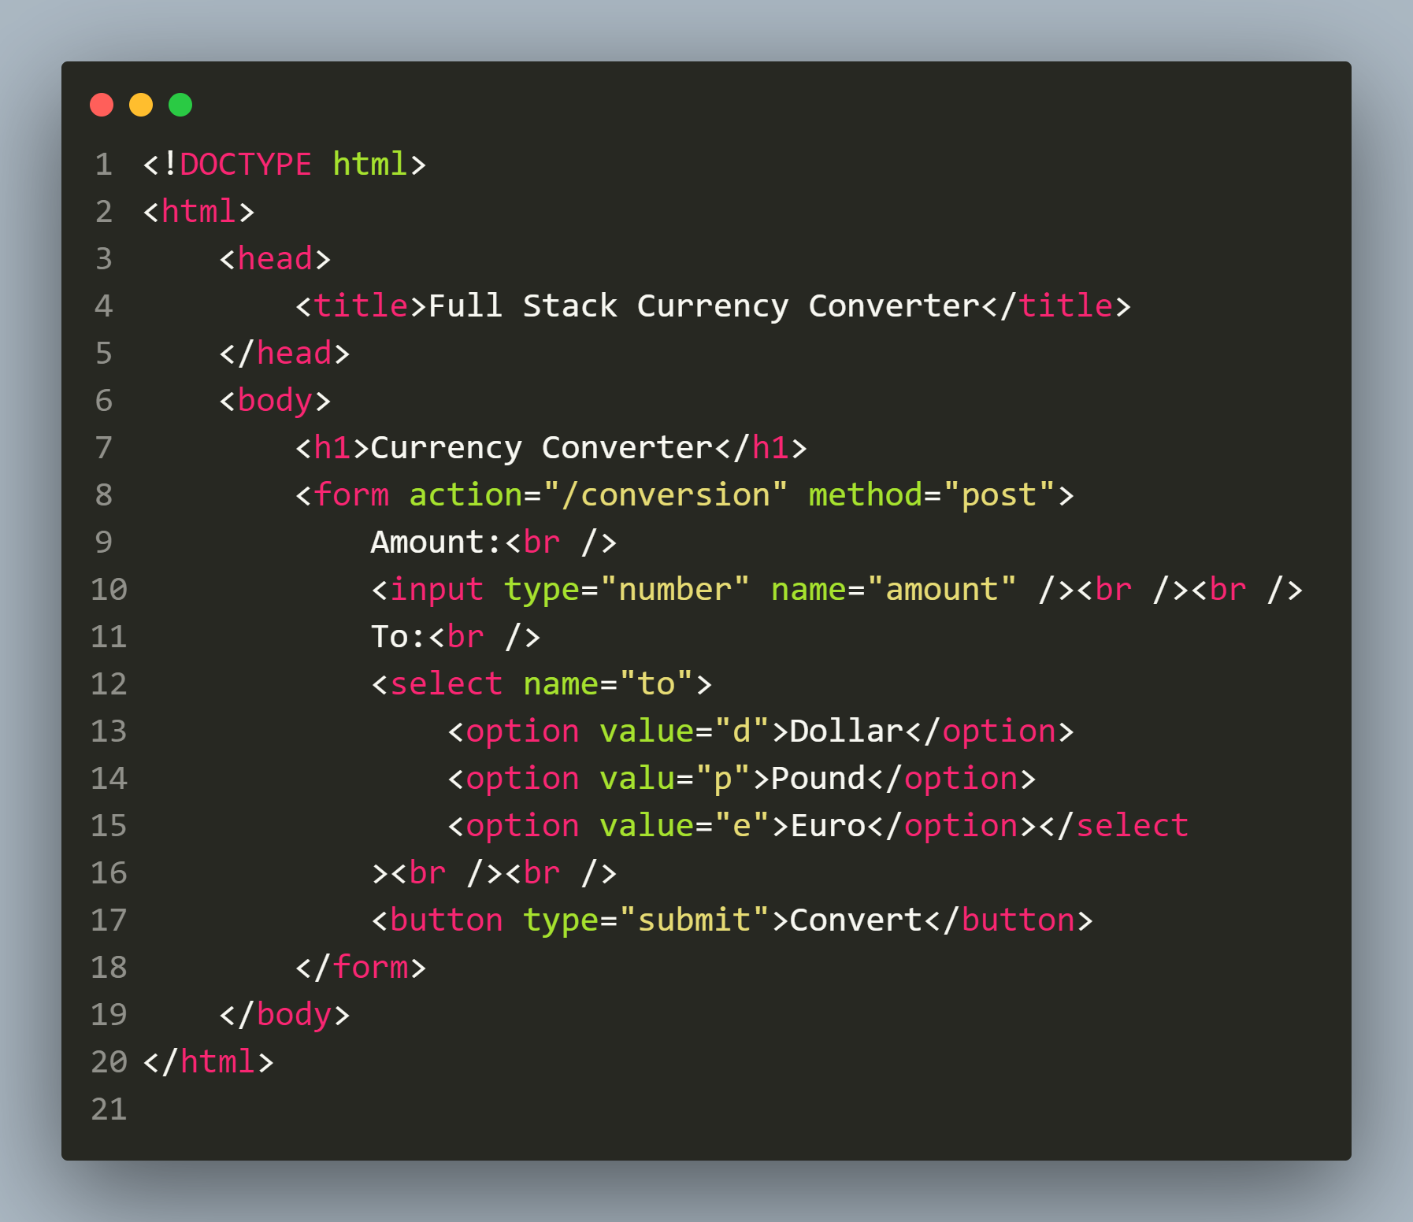
Solution
conversion.html

Slide 19
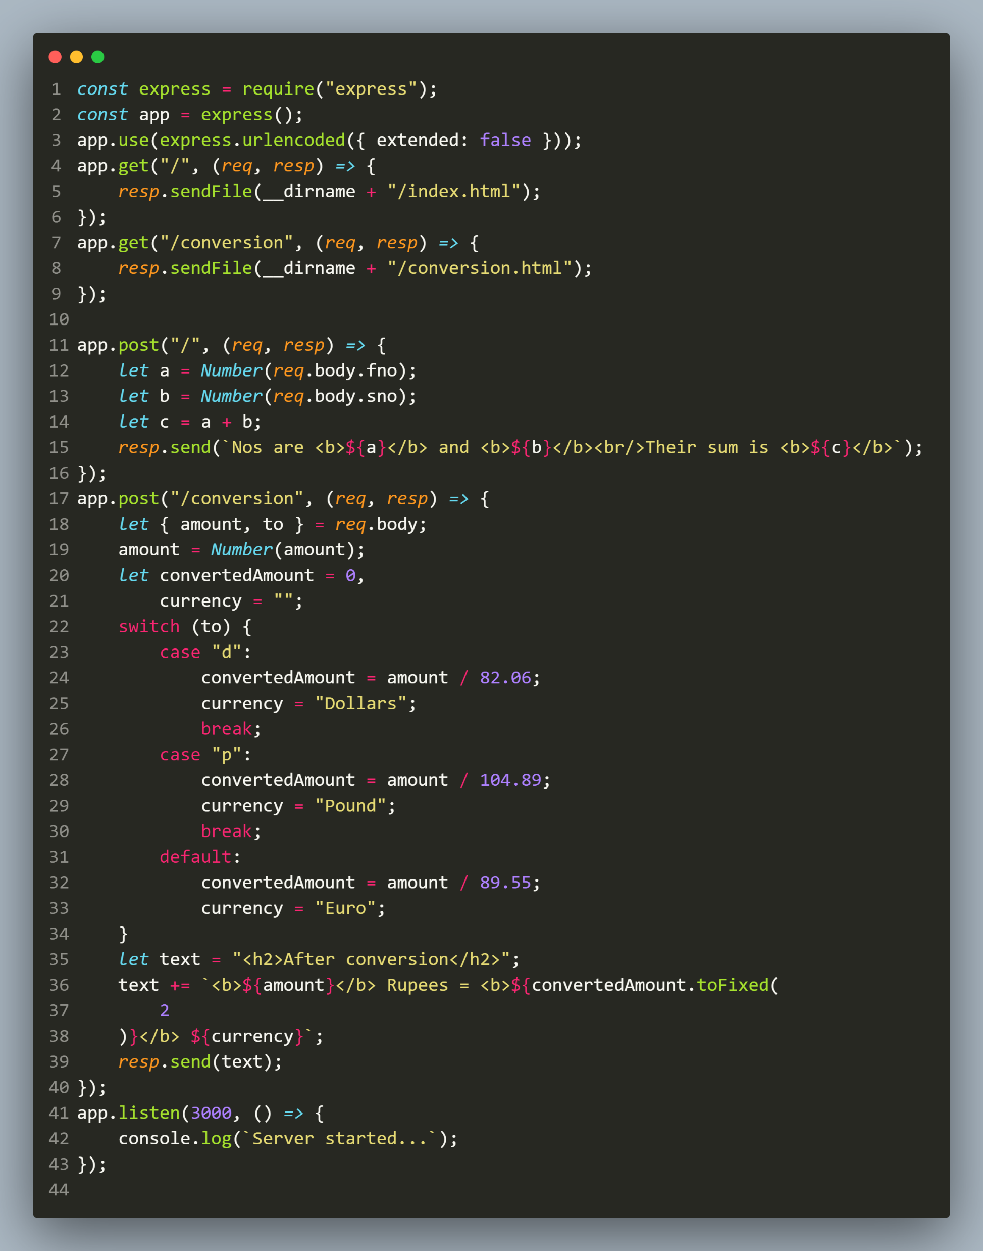
calculator.js

